Slide 1






Probabilistic Image Registration via Deep Multi-class Classification: Characterizing Uncertainty
UNSURE2019, MICCAI, Shenzhen
Alireza Sedghi, Tina Kapur, Jie Luo, Parvin Mousavi, and William Wells III
Notes:
Good afternoon/evening
My name is Jie luo and It is my pleasure to be here today, to present our recent work on the probabilistic image registration using deep multi-class classifiers.

Slide 2
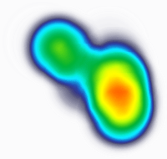
Motivation: Image Registration Uncertainty Estimation
It would be valuable for the registration methods to also predict local estimates of the registration uncertainty. So that the user can:
choose not to depend on registration results, if the uncertainty is high
place more confidence in the results when the method predicts low uncertainty
https://images.app.goo.gl/JbLuUSpUhh7CgaYF8
Notes:
Image registration is a critical element in many image-guided therapy applications
Systems like neuro-navigation that register pre-operative images to the intra-operative coordinate space of the patient
A highly desirable feature of such systems is to also predict local estimates of the registration uncertainty
This information could be used to let the user ……….. > talk about the bullet points
So, uncertainty estimation in image registration methods is highly desirable

Slide 3
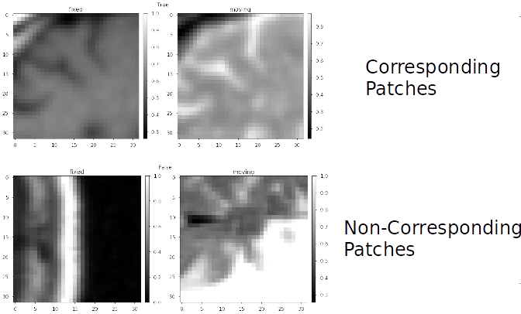
Background: Deep Metrics Registration (DMR)
Simonovsky et al. (2016) MICCAI:
Method: A deep binary classifier to distinguish between registered and unrelated 3D patches
Image agreement: posterior probability that patches are registered
Registration: gradient descent over aggregated score over a collection of patch pairs
Notes:
Deep metrics Registration or DMR have been proposed previously and they have shown superior performance compared to conventional methods.
The essential idea in the DMR approach is to prepare two classes of training data.
One class, referred to as registered, contains pairs of corresponding patches, while the
other, referred to as unrelated, contains pairs of patches that are randomly and independently sampled in location

Slide 4
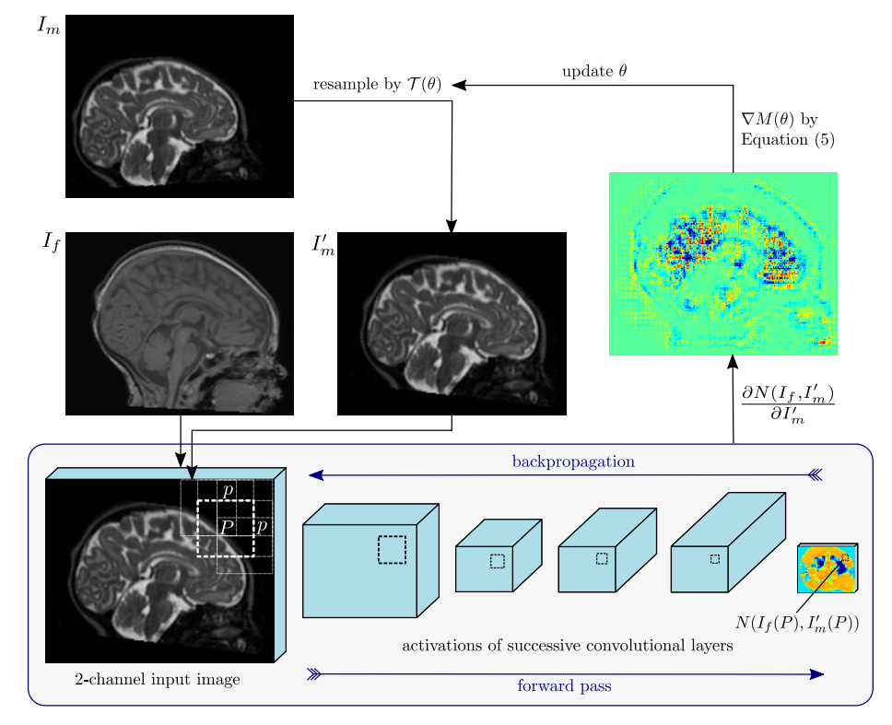
Background: Deep Metrics Registration (DMR)
Simonovsky et al. (2016) MICCAI:
Method: A deep binary classifier to distinguish between registered and unrelated 3D patches
Image agreement: posterior probability that patches are registered
Registration: gradient descent over aggregated score over a collection of patch pairs
Notes:
The class-labeled patch pairs are used to train a deep classifier
Subsequently, at registration time, the posterior probability that patches are registered is used as a measure of image agreement, and an aggregate score over a collection of patch pairs is optimized through gradient descent.

Slide 5
Our Contributions:
New formulation of DMR beyond binary classification
Multi-class classification of various displacement classes
Alleviating the need for registration-time optimization by gradient descent
posterior probabilities on classes are used to directly predict expected values of displacements on the lattice of sampled locations.
Direct calculation of the registration uncertainty
Notes:
As our contribution in this paper, we provide a new formulation for DMR beyond binary classification beyond a binary classifier,
We train a deep classifier on different displacement classes.
Our approach doesn’t need optimization by gradient descent as posterior probabilities on classes are used to directly predict expected displacements
And finally our approach provides direct calculation of the registration uncertainty.

Slide 6
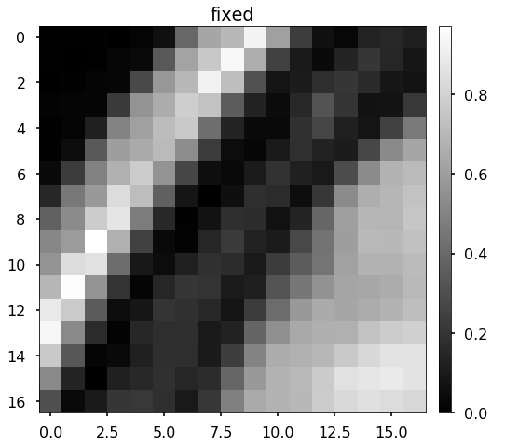
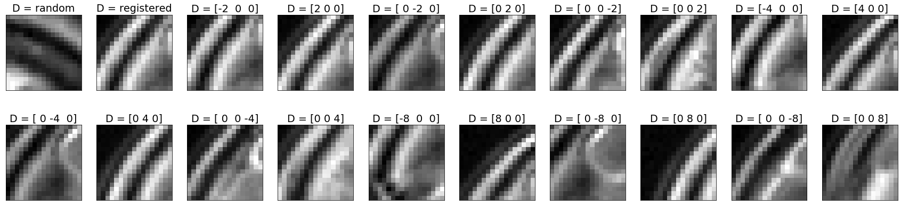
Method
Training a deep multi-class classifier on various classes of displacements
Fixed image Patch
Moving image Patches
Notes:
As I mentioned, instead of training a deep classifier on two classes (registered and unrelated or random)
(Click for animation)

Slide 7
Method
Training a deep multi-class classifier on various classes of displacements
Fixed image Patch
Moving image Patches
Notes:
We define 20 class of displacements to train such classifier. Namely plus minus 2,4,8 voxels in x,y,z direction.
(note for youself: 20 classes doesn’t need to be 20, it can be anything as long as there is a meaningful jump between classes, not like 2,10 , some smooth transition between classes. Also, maximum 8 voxel displacement is because of our patch size which is 17x17x17, 8 voxel is the middle of the 17 voxel, so we make sure the patches have at least some (~50%) overlap so that the deep model can learn something.)

Slide 8
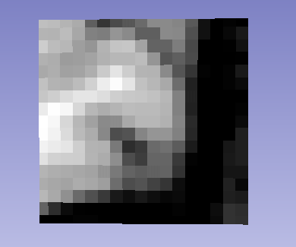
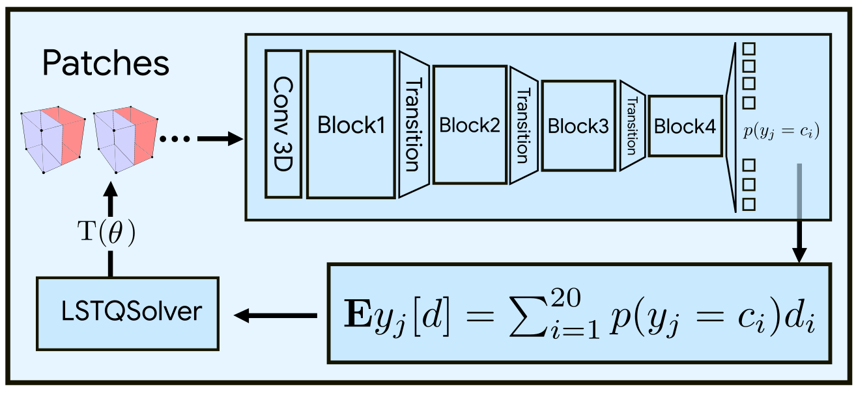
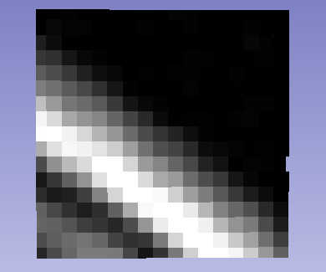
Training
Random
Notes:
We extract 3D patches from the fixed and moving image, and train a deep convolutional classifier on 20 classes of data, for example a random class as depicted here

Slide 9

Training
D = [0,0,-8]
Notes:
And a -8 voxel displacement in z direction as depicted here

Slide 10
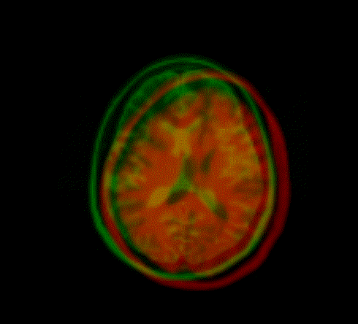
Registration
Notes:
Next, at registration time,
We extract 3D patches from the transformed moving image and the corresponding locations in the fixed image
that are centered on the control points.
Posterior probabilities are used to calculate an estimated displacement for each control point.
For B-spline models, increment the control points with their respective expected displacements; otherwise, use the control points and predicted displacements to calculate a least squares estimate of the rigid/affine transformation parameters.

Slide 11
Results
Notes:
We have done various rigid affine and bspline experiments on T1, T2 image registration for inter and intra –subject registration with artificially placed tumors.
As I said our probabilistic deep classifier can be used to directly calculate the uncertainty of registration as depicted in the images.
We also performed a quantitative analysis of the actual error in registration and our predicted uncertainty which is shown here
We observe a strong positive linear relationship between the uncertainty and actual errors of registration ($r = 0.94$ with $p < 0.001$), and importantly, low levels of predicted
uncertainty correspond to low levels of actual error.

Slide 12
The End
Notes:
Thank you for your time and I would be glad to talk more about our methodology and results in the poster session.

